Slide 1
Netflix Trend 2019

Slide 2
Team Members :
1) 2) 3)
4)

Slide 3
Objective:
This dataset includes of Netflix-eligible television series and feature films as of 2019. The dataset was gathered through the third-party Netflix search engine Flixable.
By using Exploratory Data Analysis:
Which Rating categories are more widely available?
Evaluating the frequency of each type and rating.
Total types that the top countries produce.
Total Movies And TV Shows Currently Present in Netflix.
What percentage of available movies and TV shows is total?
Total released ever year.

Slide 4
Core Components:
For writing the code we have used:
Python ,Pandas
For Executing the script used
Jupyter Notebook
Dataset references :India: Coronavirus Pandemic Country Profile - Our World in Data

Slide 5
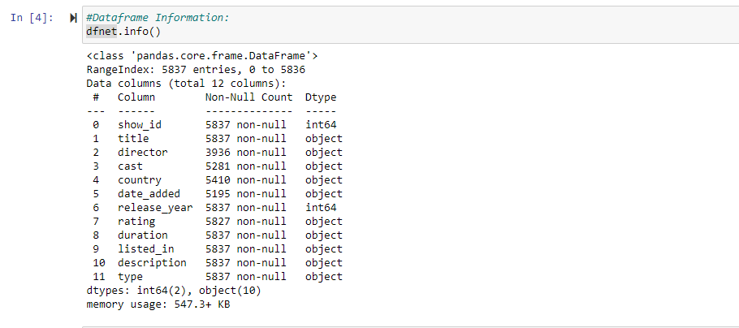
DATASET INFORMATION: 5837 Records, 12Columns

Slide 6
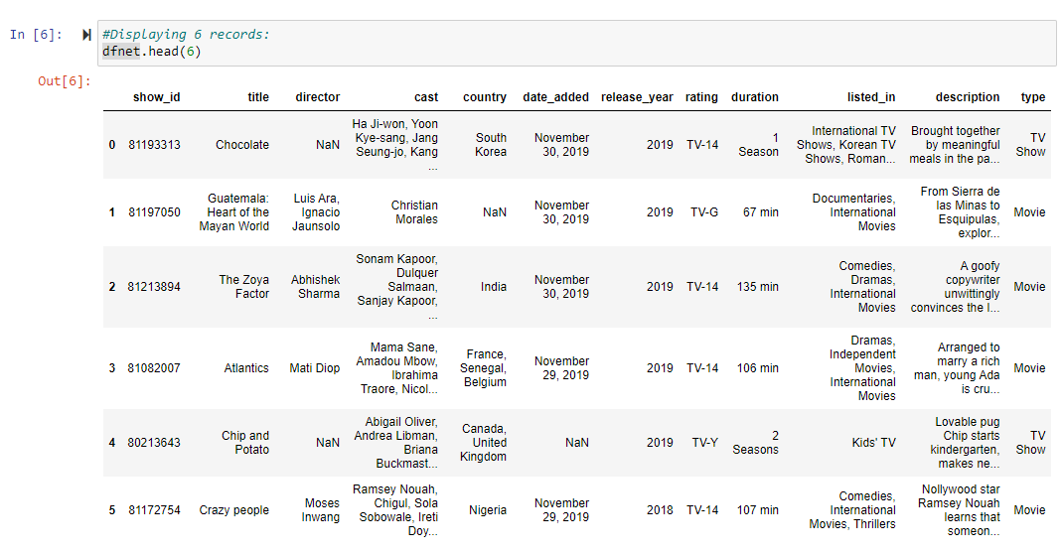
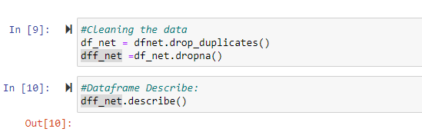
Sample Data:
Pre-Processing Data:

Slide 7
THANK YOU

